Slide 1
Process N3-N3+ IN METIS
18/03/2022
V1.0

Slide 2
AGENDA
Principles of the process
Rules for CAP RUN teams
Rules for N3+ teams
Process workflow
Use of the N3+ model
Operations follow-up

Slide 3
Principles
Perimeter : any tower – MWR included
Goal : measure solicitations of Cagip teams and progress in CAP teams autonomy regarding N3 activities
When CAP Run team will need CAGIP N3+ assistance on incident, request or change, CAP will create :
a dedicated incident ticket (that we will call N3+ ticket)
based on the model : OPEN_Support_N3_N3+ | Template | ServiceNow (service-now.com)
assigned to the build team
linked to the initial ticket (that we will call ticket A) for which assistance is needed
Those specific N3+ ticket will be counted to identify solicitations
Once created by CAP, the N3+ ticket will be managed only by N3+ team to provide an answer that could be :
Rejected if the process is not correctly followed
Validation or advices
Requirement to transfer ticket A that would be then entirely managed by N3+
When the N3+ ticket is solved by N3+, CAP team would get the answer within the ticket and proceed accordingly.

Slide 4
RULES
On CAP Run team side:
Only a referent can create N3+ ticket using the model only, it the result of his analysis requires N3+ assistance
The analysis done by CAP must be written in the notes of ticket A before escalation to N3+
Possible reasons to require assistance
Propose an action plan and ask for N3+ control/validation
Crisis escalation (P1/P2 major incidents)
Analysis required from N3+
For P1/P2 majors incidents, escalation can be done by any means (skype, phone) to facilitate escalation. The N3+ ticket must also be created in parallel.
Asking for N3+ assistance is not a reason to put a ticket on hold ➔ ticket A must not be put on hold because N3+ ticket has been created and N3+ answer is expected.
If N3+ ticket resolution code is “solved(permanently)” ticket A must be transferred to N3+, in any other case, ticket A remains managed by RUN team.
This process applies for any kind of need
Incident → Creation of support N3+ ticket as a child of the incident
Request Task → Creation of support N3+ ticket and put the reference number ticket N3+ in the task
Problem Task → Creation of support N3+ ticket and put the reference number ticket N3+ in the task
Change → Creation of support N3+ ticket and put the reference ticket (at least 7 days before due date to have room to check)

Slide 5
RULES
On N3+ Side : how to manage N3+ ticket
Case 1 : after N3+ analysis, assistance is required wrongly : not coming from referent, not respecting the process and model, no analysis in ticket A , subject is already know by CAP
➔ Action : resolve ticket with resolution code « rejected » - gives the reason of reject in resolution notes
Case 2 : after N3+ analysis, the ticket A has to be fully managed by N3+
➔ Action : resolved ticket with resolution code « solved(permanently) » - confirm “Transfer ticket” in resolution notes
Case 3 : after N3+ analysis, information is provided to support CAP Run team for resolution (validation of CAP action plan, explanation, documentation…)
➔ Action : resolved the ticket resolution code « solved(workaround) » - indicate in resolution notes the answer or where the answer can be found (N3+ notes, document, mail…)

Slide 6
N1/N2 Domain xxxx – Techno YYY
Group CAGIP-OPN-XXX-YYY_SUPPORT
N3 Domain xxxx – Techno YYY
Group CAGIP-OPN-XXX-YYY_SUPPORT
N3+ Domain xxxx – Techno YYY
Group CAGIP-OPN-XXX-YYY-BUILD
Mail Build + support
Analysis
Ticket A
1st Assignment
Analysis
Analysis
Ticket N3+
Assignment
Ticket A
Update with the results of analysis
N3 is needed ?
Yes
Ticket A
Assignment to the referent N3
Creation of support N3+ incident (lien vers le modèle)
Ticket A
Update
Ticket N3+
Update / closing
No
N3+ is needed ?
Yes
No
Update Knowlegde DB
Yes
Check Update
Resolution can be done by N1/N2/N3?
Resolution
Resolution
Ticket A
Assignment
No
Ticket A update
Closing
Transfer Ticket A to N3+
Ticket A update
Closing

Slide 7
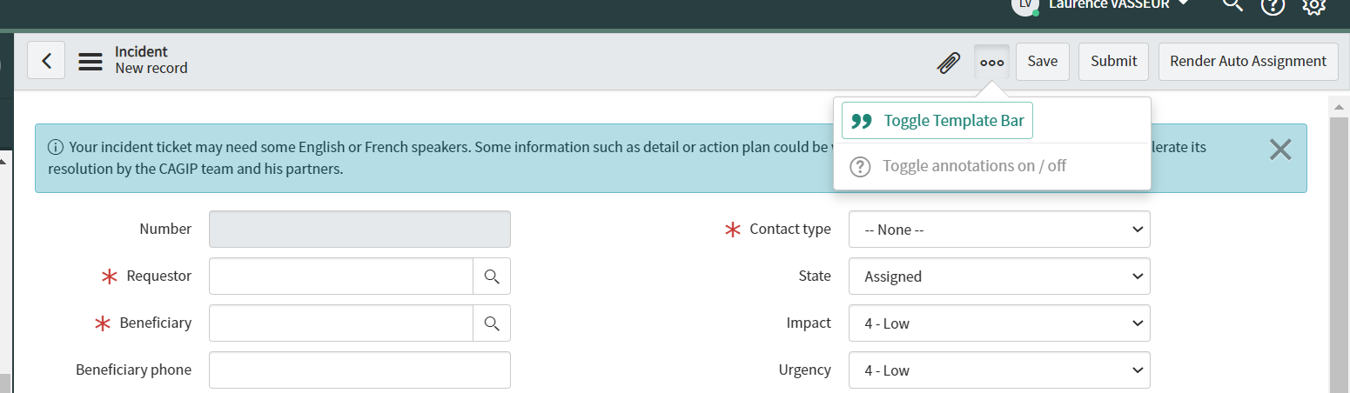
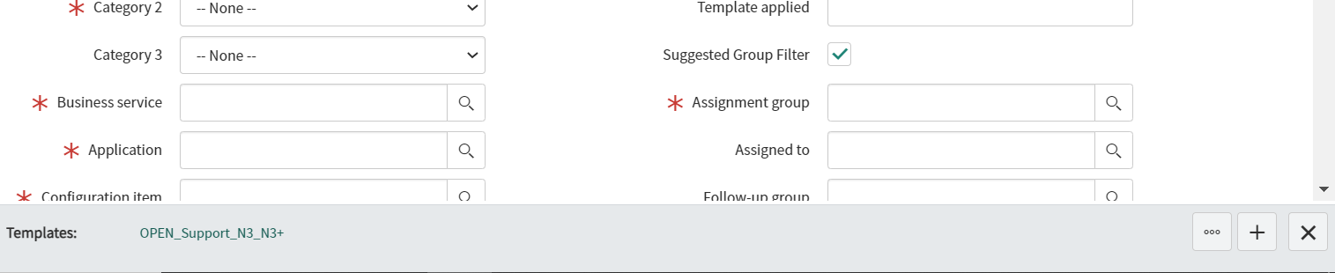
USE of the model to create N3+ ticket (1/2)
Step 1 : create incident (son or new)
Step 2 : activate model bar :
Click on « … » (top of the screen)
Then Click on « toggle template bar »
Step 3 : select model :
- Click on « Open_Support_N3_N3+ » in template bar (bottom of the screen)

Slide 8
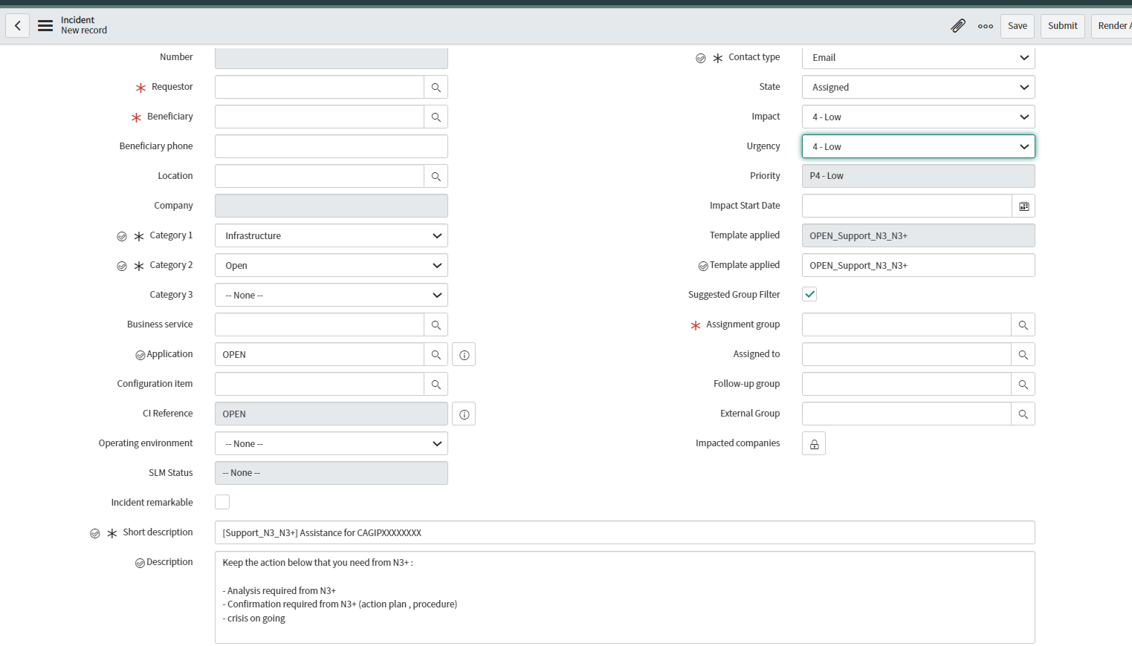
USE of the model to create N3+ ticket (2/2)
Step 4:
check that the model has been applied
Step 5: fill the ticket in
Requestor and Benificiary : referent name of the tower
Impact / Urgency : to be modified only for assistance on incident. Apply same impact / urgency than Ticket A
Select the N3+ group of the tower
Replace CAGIPXXXX by the ID of the Ticket A
Keep the line that correspond to the assistance needed and remove the 2 others. NO additional input
Step 6: save the ticket
a
b
b
c
c
a
d
d
e
f
e
f

Slide 9
Operations FOLLOW-UP
Operational follow-up can be done through a METIS report (report to be shared)
Indicators will be created :
Number of N3+ tickets per tower per week
Number of N3+ tickets rejected
Number of N3+ tickets solved(workaround)
Number of N3+ tickets solved(permanently)
Indicators can be used and discussed in all committees, and actions plan for rejected tickets will be followed as well
Impact KPI calculation:
as N3+ tickets are assigned to N3+ team they will not be counted in contract KPI
we will modify NSC-OP-06 calculation to add N3+ tickets numbers linked to Incident and Problems to the count of escalated tickets to N3+
if a ticket A breach SLA rule because of N3+ delay, it could be removed from calculation if
N3+ ticket was not rejected
N3+ ticket was created with enough time for N3+ to analyze, answer and solution to be applied by RUN or N3+
N3+ has been informed respecting the process (mail) or (skype/phone for P1/P2 major incidents)

